Slide 1
SLO 1.1.1
Apply Digital Analysis
Describe Incident Response Policy and Governance

Slide 2

The Grey Zone…
“A new type of war has emerged, in which armed warfare has given up its decisive place in the achievement of the military and political objectives of war to another kind of warfare
– information warfare.”
- Vladimir Kvachkov, Russia’s Special Purpose Forces, 2004

Slide 3
ADF, Ethics and Cyber Response
This presentation is designed for students of Cyber Security.
It contains material for Cyber Security professionals.
It does not teach about specific ADF policies.
Notes:
Make a note to the students that the presentation is aimed at creating cybersecurity professionals.
This module does not specifically teach about ADF policies.

Slide 4
Contents
ADF
Background
Joint Capabilities Group (JCG)
Conceptual Framework
Cyber and Warfare Domains
Ethics
ADF Core Values
Ethical Considerations
Whole of Government Cyber Capabilities
ADF Cyber Structure
RACI Model

Slide 5
Background
Current threats to the ADF
Cyber Security has become a mainstream threat
Cyber-attacks are coming from Nation States, Criminals and Hacktivists
In response to the changed environment the Information Warfare Division was established
Notes:
Background
The ADF faces three key existential threats emanating from cyber security and information warfare
Nation-states who using cyber security capabilities against Australia and its allies as part of an extension of their armed forces
Non-state actors and state sponsored actors such as terrorist organizations, insurgency groups and criminal gangs
Hybrid or grey-zone threats from either state and/or non-state actors
These real threats to Australia’s national and strategic interests are an important baseline for ADF’s considerations on how to meet cyber security challenges?
The ADF needs to coordinate policies, processes and procedures to ensure that the strategic, operational and tactical levers of war are fully addressed for Australia’s defensive and offensive cyber security settings

Slide 6

ADF Information – Joint Capabilities Group
Joint Capabilities Group (JCG) is a multi-domain Group comprising of Space, Cyber and the Defence Networks, while delivering Strategic Military Effects and Logistics for the Defence Enterprise.
JCG’s mission is to prepare Space and Cyber Power, and Logistics capabilities, in order to enable the integrated force in competition and conflict.

Slide 7

ADF Information – Joint Capabilities Group
Divisions and Commands
Cyber Command
Defence SIGINT and Cyber Command
Space Command
Cyber Operations Division
Joint Capabilities Division
Joint Logistics Command
Military Strategic Effects Branch
https://www.defence.gov.au/about/who-we-are/organisation-structure/joint-capabilities-group
Notes:
ADF Information Warfare Division
The Information Warfare Division (IWD) was formed in 2017 under Joint Capabilities Group within the Department of Defence. Its formation was part of an initiative by the Australian Government to combat threats to Australia’s national interests in the information environment. Major General Susan Coyle, CSC, DSM is the current Head of Information Warfare Division (HIW).

Slide 8
ADF Information – Joint Capabilities Group
Cyber Command
On 25 March 2024, Cyber Command (CYBERCOMD) was activated, transitioning from what was formerly known as Cyber Warfare Division. The vision of CYBERCOMD is ADF dominance of the Cyber Domain. The CYBERCOMD mission is to prepare cyber domain, in order to enable the integrated force in competition and conflict.
Notes:
ADF Information Warfare Division
The Information Warfare Division (IWD) was formed in 2017 under Joint Capabilities Group within the Department of Defence. Its formation was part of an initiative by the Australian Government to combat threats to Australia’s national interests in the information environment. Major General Susan Coyle, CSC, DSM is the current Head of Information Warfare Division (HIW).

Slide 9

Video

Slide 10
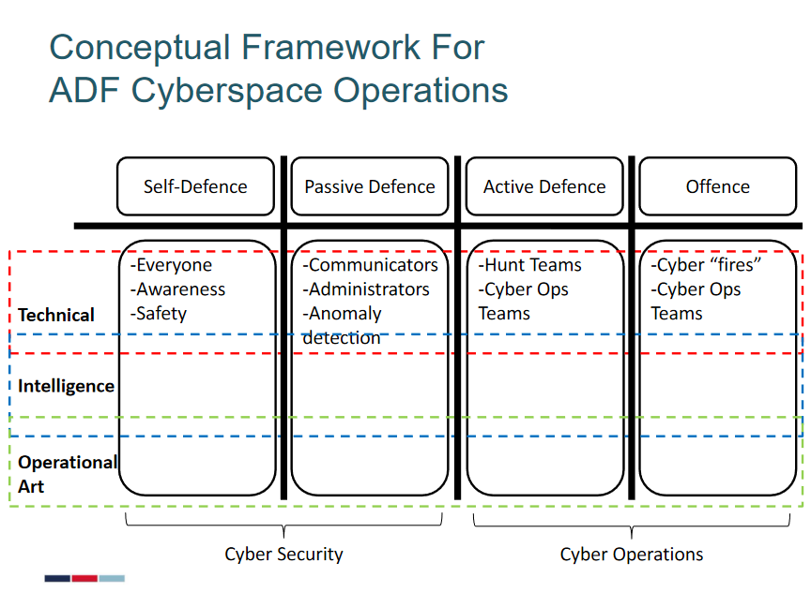
Conceptual Framework
In early 2018 the IWD released the Information Warfare Strategy, which identified four areas of capability:
Self-Defence
Passive Defence
Active Defence
Offence.
https://www.defencewatch.com.au/defencewatch_files/Cyber20/Defence%20Watch%202020_MAJGEN%20Thompson.pdf
Notes:
Conceptual Framework
The ADF has developed an early framework for this concept development. It provides an initial insight into the frames the ADF will use to develop its theory of conduct in the information environment.
Self-Defence involves all ADF members. It is the foundation for ADF cyberspace capabilities and will transform ADF culture to ensure every ADF member is fully-versed in cybersecurity norms and procedures. It means making cyber part of an ADF member’s daily responsibilities, the new normal for everyone. Cyber safety should become as familiar as smartphone use is, and as easy as ensuring the door is locked before you leave the house.
Passive Defence relates to all ADF communicators’ and network administrators’ management of ADF networks and mission systems. It means system operators will be trained and equipped to detect, triage, and resolve network or system anomalies in the information environment. It is basic cyber housekeeping for the ADF as a digitally-enabled, modern organization.
Active Defence is conducted by specialists to elevate the cyber response via more technical capabilities that are operated by small numbers of highly-trained personnel. These professionals will be “hunt-teams” who are threat-focused but operating on friendly systems. Their role as specialists is in the defense of ADF systems, but not in attacking other systems.
Offensive means the ADF will attack the systems and capabilities of actors viewed as hostile to the ADF or its operations, to ensure missions are achieved and ADF personnel and systems are safe. These activities will remain highly classified and stand in best analogy to “fires” in traditional domains. These fires will occur in the cyber domain. The ADF’s activities here will be legally authorized and cohere precisely with Australia’s expressed national intent.
Morgan, E., & Thompson, M. (2018). Building Allied Interoperability in the Indo-Pacific Regions. Information Warfare: An Emergent Australian Defence Force Capability, Discussion Paper 3.
181023_InformationWarfare.pdf (csis-website-prod.s3.amazonaws.com)

Slide 11
Ethics
Ethics is a branch of philosophy (fundamental nature of knowledge, reality and existence)
Ethics considers:
People’s values,
Moral principles,
How people translate these values into cyber security behavior
Notes:
At its simplest, ethics is a system of moral principles. They affect how people make decisions and lead their lives. Ethics is concerned with what is good for individuals and society and is also described as moral philosophy. The term is derived from the Greek word ethos which can mean custom, habit, character or disposition.
Ethics covers the following dilemmas:
how to live a good life
our rights and responsibilities
the language of right and wrong
moral decisions - what is good and bad?

Slide 12

ADF Core Values
Service – selflessness of character to place the security and interests of our nation and its people ahead of my own
Courage – the strength of character to say and do the right thing, especially in the face of adversity
Respect – the humanity of character to value others and treat them with dignity
Integrity – the consistency of character to align thoughts, words and actions to do what is right
Excellence – the willingness of character to strive each day to be the best I can be, both professionally and personally.
Notes:
ADF Core Values
Participants will already know and be familiar with the values so this is just a reminder.
ADF Behaviours include:
Act with purpose for Defence and the nation.
Be adaptable, innovative and agile.
Collaborate and be team-focused.
Be accountable and trustworthy.
Reflect, learn and improve.
Be inclusive and value others.

Slide 13

Cyber Ethics – ADFA quote
"The ethical principles that govern kinetic military operations—those enshrined in Just War Theory—are often difficult to apply to cyberwarfare.
The traditional distinction between “combatants” and “non-combatants”, and between state and non-state actors, tends to be opaque in cyberspace. Moreover, cyber operations raise ethical dilemmas beyond those that are raised by conventional armed conflict.
For instance, those involved in so-called information warfare campaigns are often required to behave in deeply manipulative ways, beyond what is typically expected of ordinary soldiers".
https://unsw.adfa.edu.au/our-research/cyber-war-ethics-policy
Notes:
Cyber Ethics – ADFA quote
This notable quote is worth reading out. This quote comes from the Australian Defence Force Academy, University of New South Wales, research institute.
The quote should be read out and then discussed amongst the students.
A question could include ‘What are some examples of where an information warfare soldier could be asked to behave in a deeply manipulative way?

Slide 14
Ethical Considerations
The ADF is underpinned by the Australian Defence Doctrine
The ADF Cyber Command has a strong record of compliance with applicable domestic and international laws
ADF’s management of cyber security risks at the core involves trade-offs between balancing security and privacy considerations
Notes:
Ethical Considerations
The ADF’s cyberspace warfare is underpinned by Australian Defence Doctrine Publication (ADDP) 3.24 Cyberspace Operations which is presently pending endorsement.
The ADF Cyber Command has a strong record of compliance with applicable domestic and international laws, so ADF personnel need to understand legal and ethical obligations in using incident response capabilities and technologies.
It is important to note that ADDP are authorized joint doctrine for the guidance of ADF operations, and articulate the ADF’s philosophical military approach to the operational environment; Doctrine unlike policy, is not prescriptive and therefore has no legal standing.

Slide 15

Ethical Considerations continued
Challenging ethical issues for ADF’s Joint Cyber Unit include:
Subjective interpretation of intent
Technological aggression
Anonymity of cyber weapons
Unintended proliferations , and
The targeting of critical infrastructure
Notes:
Ethical Considerations continued
Subjective interpretation of intent
Can Cyberspace warfare be undertaken ethically? Proportionality and discrimination must be answered in conjunction with determining if the use of traditional forms of military force may be used in retribution, or whether it is more appropriate to launch a counter cyber-attack. Therefore, in the absence of a framework that provides a moral value to a non-physical entity i.e. national IT network, a commander is required to determine the intent of a cyber-attack, based on one’s own interpretation. Leading to further consideration as whether one should respond in kind or consider a pre-emptive defensive strike against an assumed timely e.g. a kinetic attack.
Technical Aggression
Will the use of non-physical force lead to physical damage, loss of life, or be more damaging than a kinetic attack? Determining the immediate or consequential effects of a cyberspace operation requires a commander to be aware of possible physical and non-physical effects.
Anonymity of Cyber Weapons
Cost effective and rapid, Cyberspace’s unregulated and limitless bounds make cyber operations “an attractive instrument of aggression”. Teamed with the advantageous ability to operate anonymously within the Cyberspace domain, inability for attribution and whether or not a cyberspace activity was an attempt at misdirection is as complex as it is subjective.
Unintended Proliferation
Cyberspace operations have the potential to result in either intended or unintended kinetic effects beyond a commander’s targeted scope. For example, malware could inflect an International Air Traffic Control system that supports both military and civilian activities, leading to an aircraft crash in which civilians would die.
Targeting of Critical Infrastructure
Limiting the damage and destruction of dual use targets such as basic infrastructure also requires a Commander to understand aspects of the targeted environment in relation to cultural and social norms and economical drivers. Additional consideration by the ADF would also include adherence to enforceable determinations such as United Nations Security Council Resolutions (UNSCR) which may uniquely impact operational or targeting considerations of a Commander i.e. UNSCR 1325 recognizes the changing nature of warfare in which civilians, in particular women and girls, are increasingly targeted and differentially impacted during conflict.

Slide 16
Ethical Considerations conclusion
Fundamental questions that the ADF needs to address are:
How we act and react?
What values should we aim to promote?
What means of anticipating and responding to the cyber security risks are reasonable and importantly, publicly justifiable.
Source: https://nsc.crawford.anu.edu.au/sites/default/files/publication/nsc_crawford_anu_edu_au/2017-05/ocassional-paper-6-cyber-ethics.pdf
Notes:
Ethical Considerations continued
Summary of ethical considerations.

Slide 17
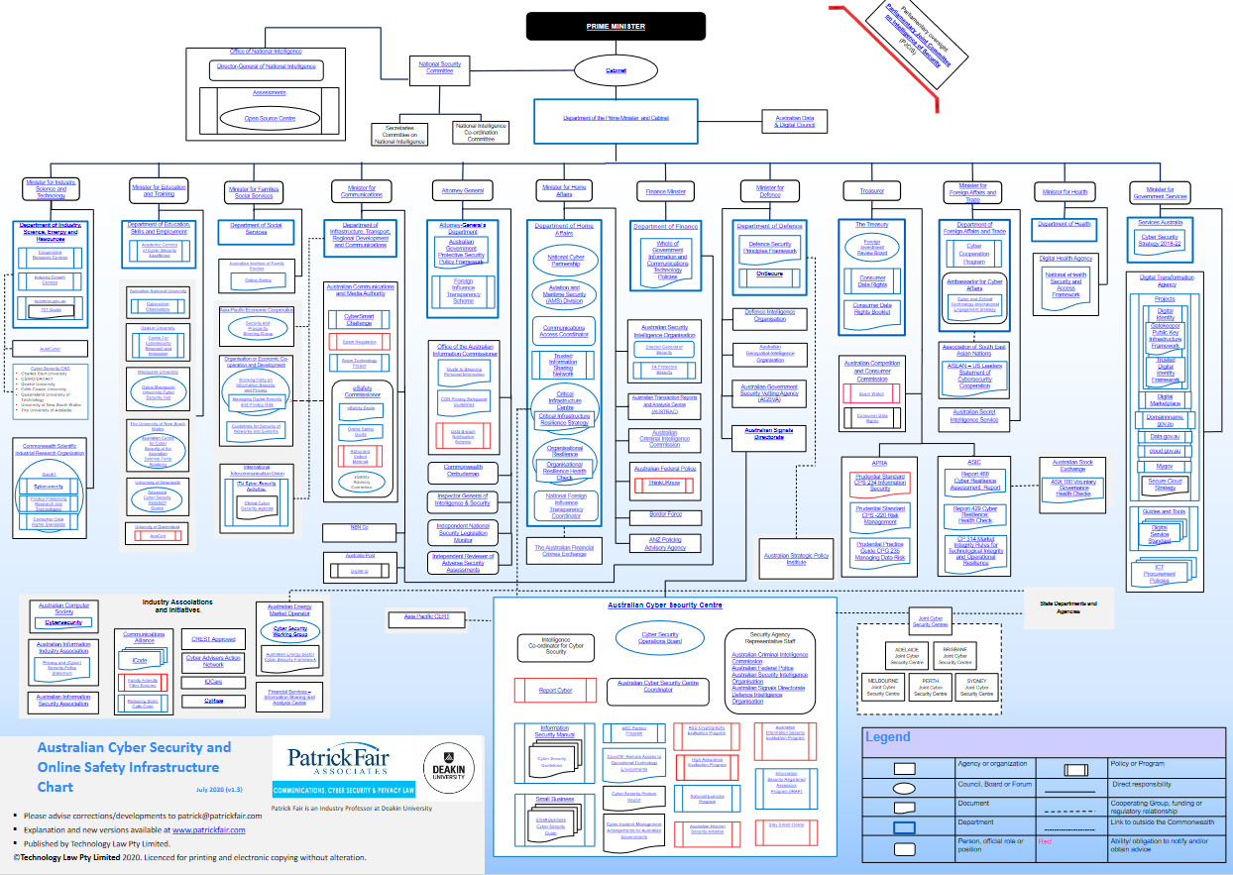
WoG Cyber Capabilities
https://baa44158-17ff-40f7-8b38-bbccd6ef65de.filesusr.com/ugd/ce391e_546b5b105fe64af79037d0d2fe70d329.pdf
Notes:
Whole of Government (WOG) Cyber Capabilities
The chart represents the Whole of Government cyber capabilities. It is very detailed. For a closer look go the webpage and focus on an area of interest.
https://baa44158-17ff-40f7-8b38-bbccd6ef65de.filesusr.com/ugd/ce391e_546b5b105fe64af79037d0d2fe70d329.pdf

Slide 18
Policy and Governance
WoG
Attorney General
Minister for Defence
Australian Signals Directorate
Department of Defence
Australian Government Protective Security Policy Framework
Australian Cyber Security Centre
Defence Security Principles Framework
Information Security Manual

Slide 19
Policy and Governance
Protective Security Policy Framework
The Protective Security Policy Framework (PSPF) helps Australian Government entities to protect their people, information and assets, both at home and overseas.
It sets out government protective security policy and supports entities to effectively implement the policy across the following outcomes.
Security governance
Information security
Personnel security
Physical security
Protective Security Policy Framework
Notes:
Security Governance – Outlines the Roles and responsibilities of Accountable Authorities and the management structures and responsibilities that determine how security decisions are made.
They set out how to plan, manage, monitor and report on protective security.
They also articulate the governance arrangements for sharing Australian Government resources with contracted service providers and foreign partners.
Information Security – Outlines how entities classify and handle official information to guard against information compromise.
They set out how to provide appropriate and secure access to official information, mitigate common and emerging cyber threats and safe guard official information and ICT systems
Personnel Security – Outlines how to screen and vet personnel and contractors to assess their eligibility and suitability.
Physical Security – Outlines physical security , control, and building construction measures to safeguard government resources.

Slide 20
Policy and Governance
Information Security Manual
The purpose of the Information Security Manual (ISM) is to outline a cyber security framework that an organisation can apply, using their risk management framework, to protect their systems and data from cyber threats.
The ISM is broken down into:
Cyber security principles and
Cyber security guidelines.
Information Security Manual (ISM) | Cybergov.au
Notes:
Cyber Security Principles – The purpose of the cyber security principles within the ISM is to provide strategic guidance on how an organisation can protect their systems and data from cyber threats.
These principles are grouped into four (4) key activities:
Govern
Protect
Detect and
Respond
Cyber Security guidelines – The purpose of the cyber security guidelines within the ISM is to provide practical guidance on how an organisation can protect their systems and data from cyber threats.
These guidelines cover:
Governance
Physical security
Personnel security and
Information and communications technology security topics

Slide 21
Policy and Governance
Information Security Manual
Cyber security principles
Govern
GOVERN-1: A Chief Information Security Officer provides leadership and oversight of cyber security.
GOVERN-2: Security risk management activities for systems, applications and data are embedded into organisational risk management frameworks.
GOVERN-3: Security risks for systems, applications and data are accepted before they are authorised for use and continuously throughout their operational life.
Notes:
Cyber Security Principles – The purpose of the cyber security principles within the ISM is to provide strategic guidance on how an organisation can protect their systems and data from cyber threats.
These principles are grouped into four (4) key activities:
Govern
G3: CIA triad
G5: Certification and Accreditation. (ICT security branch)

Slide 22
Policy and Governance
Information Security Manual
Cyber security principles
Identify
The Identify principles are:
IDENTIFY-1: The business criticality of systems, applications and data is determined and documented.
IDENTIFY-2: The confidentiality, integrity and availability requirements for systems, applications and data are determined and documented.
IDENTIFY-3: Security risks for systems, applications and data are identified and documented
Notes:
Cyber Security Principles – The purpose of the cyber security principles within the ISM is to provide strategic guidance on how an organisation can protect their systems and data from cyber threats.
These principles are grouped into four (4) key activities:
Protect
P2: Supply chain attacks. (Jumped 51% in 2021)
SolarWinds – Software update from SolarWinds own servers.
Log4j – Is a logging utility. That allows RCE.

Slide 23
Policy and Governance
Information Security Manual
Cyber security principles
Protect
PROTECT-1: Systems and applications are designed, deployed, maintained and decommissioned according to their business criticality and their confidentiality, integrity and availability requirements.
PROTECT-2: Systems and applications are delivered and supported by trusted suppliers.
PROTECT-3: Systems and applications are designed and configured to reduce their attack surface.
PROTECT-4: Systems, applications and data are administered in a secure and accountable manner.
PROTECT-5: Vulnerabilities in systems and applications are identified and mitigated in a timely manner.
PROTECT-6: Only trusted and supported operating systems, applications and code can execute on systems.
PROTECT-7: Data is encrypted at rest and in transit between different systems.
Notes:
Cyber Security Principles – The purpose of the cyber security principles within the ISM is to provide strategic guidance on how an organisation can protect their systems and data from cyber threats.
These principles are grouped into four (4) key activities:
Protect
P2: Supply chain attacks. (Jumped 51% in 2021)
SolarWinds – Software update from SolarWinds own servers.
Log4j – Is a logging utility. That allows RCE.

Slide 24
Policy and Governance
Information Security Manual
Cyber security principles
Protect
PROTECT-8: Data communicated between different systems is controlled and inspectable.
PROTECT-9: Applications, settings and data are backed up in a secure and proven manner on a regular basis.
PROTECT-10: Only trusted and vetted personnel are granted access to systems, applications and data.
PROTECT-11: Personnel are granted the minimum access to systems, applications and data required to undertake their duties.
PROTECT-12: Robust and secure identity and access management is used to control access to systems, applications and data.
PROTECT-13: Personnel are provided with ongoing cyber security awareness training.
PROTECT-14: Physical access to systems, supporting infrastructure and facilities is restricted to authorised personnel
Notes:
Cyber Security Principles – The purpose of the cyber security principles within the ISM is to provide strategic guidance on how an organisation can protect their systems and data from cyber threats.
These principles are grouped into four (4) key activities:
Protect
P11: Role, Based, Administration
P12: Multi factor authentication

Slide 25
Policy and Governance
Information Security Manual
Cyber security principles
Detect
DETECT-1: Event logs are collected and analysed in a timely manner to detect cyber security events.
DETECT-2: Cyber security events are analysed in a timely manner to identify cyber security incidents.
Respond:
RESPOND-1: Cyber security incidents are reported internally and externally to relevant bodies and stakeholders in a timely manner.
RESPOND-2: Cyber security incidents are analysed, contained, eradicated and recovered from in a timely manner.
RESPOND-3: Incident response, business continuity and disaster recovery plans support the recovery of normal business operations during and following cyber security incidents
Notes:
Cyber Security Principles – The purpose of the cyber security principles within the ISM is to provide strategic guidance on how an organisation can protect their systems and data from cyber threats.
These principles are grouped into four (4) key activities:
Detect and
D2: Security Incident and Event management (SIEM) Defence use Splunk
Respond
R1: XP188 (web forms)

Slide 26
Policy and Governance
Information Security Manual
Guidelines for Cyber Security Incidents
Managing cyber security incidents
Cyber security incident management policy.
Control: ISM-0576, A cyber security incident management policy, and associated cyber security incident response plan, is developed, implemented and maintained.
Control: ISM-1784, The cyber security incident management policy, including the associated cyber security incident response plan, is exercised at least annually.
Notes:
The following are some of the data sources that an organisation can use for detecting and investigating cyber security incidents:
▪ Domain Name System event logs: Can assist in identifying attempts to resolve malicious domains or Internet Protocol addresses which can indicate an exploitation attempt or successful compromise.
▪ Email server event logs: Can assist in identifying users targeted with spear-phishing emails. Can also assist in identifying the initial vector of a compromise.
▪ Gateway event logs: Can assist in identifying anomalous or malicious network traffic which can indicate an exploitation attempt or successful compromise.
▪ Operating system and application event logs: Can assist in identifying anomalous or malicious activity which can indicate an exploitation attempt or successful compromise.
▪ Remote access event logs: Can assist in identifying unusual source addresses, times of access and logon/logoff times associated with malicious activity.
▪ Web proxy event logs: Can assist in identifying Hypertext Transfer Protocol-based vectors and malicious network traffic

Slide 27
Policy and Governance
Information Security Manual
Guidelines for Cyber Security Incidents
Responding to cyber security incidents.
Handling and containing malicious code infections
Control: ISM-0917, When malicious code is detected, the following steps are taken to handle the infection:
The infected systems are isolated
All previously connected media used in the period leading up to the infection are scanned for signs of infection and isolated if necessary
Antivirus software is used to remove the infection from infected systems and media.
If the infection cannot be reliably removed, systems are restored from a known good backup or rebuilt.

Slide 28
Policy and Governance
Information Security Manual
Guidelines for Cyber Security Incidents
Responding to cyber security incidents.
Handling and containing intrusions
Control: ISM-1731, Planning and coordination of intrusion remediation activities are conducted on a separate system to that which has been compromised.
Control: ISM-1732, To the extent possible, all intrusion remediation activities are conducted in a coordinated manner during the same planned outage.

Slide 29
Policy and Governance
Information Security Manual
Guidelines for Cyber Security Incidents
Responding to cyber security incidents.
Integrity of evidence
Control: ISM-0138, The integrity of evidence gathered during an investigation is maintained by investigators:
Recording all of their actions
Maintaining a proper chain of custody
Following all instructions provided by relevant law enforcement agencies.

Slide 30
Policy and Governance
Information Security Manual
Guidelines for Security Documentation
System-specific security documentation.
System security plan
Control: ISM-0041, Systems have a system security plan that includes an overview of the system (covering the system’s purpose, the system boundary and how the system is managed) as well as an annex that covers applicable controls from this document and any additional controls that have been identified and implemented.

Slide 31
Policy and Governance
Information Security Manual
Guidelines for Security Documentation
System-specific security documentation.
Cyber security incident response plan
Control: ISM-0043, Systems have an incident response plan that covers the following:
Guidelines on what constitutes a cyber security incident
The types of cyber security incidents, likely to be encountered and the expected response to each type
How to report cyber security incidents, internally to an organisation and externally to relevant authorities
Other parties which need to be informed in the event of a cyber security incident
The authority, or authorities, responsible for investigating and responding to cyber security incidents
The criteria by which an investigation of a cyber security incident would be requested from a law enforcement agency, the Australian Cyber Security Centre or other relevant authority
Steps necessary to ensure the integrity of evidence relating to a cyber security incident
System contingency measures or a reference to such details if they are located in a separate document
Notes:
This is part of a systems Certification & Accreditation. (ICT Security Branch)

Slide 32
Policy and Governance
Information Security Manual
Guidelines for Media
Media usage
Labelling media
Control: ISM-0332, Media, with the exception of internally mounted fixed media within ICT equipment, is labelled with protective markings reflecting its sensitivity or classification.
Classifying media
Control: ISM-0323, Media is classified to the highest sensitivity or classification of data it stores, unless the media has been classified to a higher sensitivity or classification.
Control: ISM-0337, Media is only used with systems that are authorised to process, store or communicate its sensitivity or classification.

Slide 33
Policy and Governance
Information Security Manual
Guidelines for System hardening
Operating system hardening
Operating system releases and versions
Control: ISM-1407, The latest release, or the previous release, of operating systems are used for workstations, servers and network devices.
Control: ISM-1408, Where supported, 64-bit versions of operating systems are used for workstations, servers, network devices and other ICT equipment.
Software firewall
Control: ISM-1416, A software firewall is implemented on workstations and servers to restrict inbound and outbound network connections to an organisation-approved set of applications and services.

Slide 34
Policy and Governance
Information Security Manual
Guidelines for System hardening
Operating system hardening
Operating system event logging
Control: ISM-0582, The following events are logged for operating systems:
Application and operating system crashes and error messages
Changes to security policies and system configurations
Successful user logons and logoffs, failed user logons and account lockouts
Failures, restarts and changes to important processes and services
Requests to access internet resources
Security product-related events
System startups and shutdowns

Slide 35
Policy and Governance
Information Security Manual
Guidelines for System hardening
Operating system hardening
Operating system event logging
Control: ISM-1976, Security-relevant events for Apple macOS operating systems are centrally logged.
Control: ISM-1977, Security-relevant events for Linux operating systems are centrally logged.
Control: ISM-0582, Security-relevant events for Microsoft Windows operating systems are centrally logged.

Slide 36
Policy and Governance
Information Security Manual
Guidelines for System hardening
Operating system hardening
Antivirus software
Control: ISM-1417, Antivirus software is implemented on workstations and servers with:
Signature-based detection functionality enabled and set to a high level
Heuristic-based detection functionality enabled and set to a high level
Reputation rating functionality enabled
Ransomware protection functionality enabled
Detection signatures configured to update on at least a daily basis
Regular scanning configuration for all fixed disks and removable media.

Slide 37
Policy and Governance
Information Security Manual
Guidelines for System Management
System patching
Patch management processes and procedures
Control: ISM-1143, Patch management processes, and supporting patch management procedures, are developed and implemented.
Control: ISM-0298, A centralised and managed approach that maintains the integrity of patches or updates, and confirms that they have been applied successfully, is used to patch or update applications, operating systems, drivers and firmware.

Slide 38
Policy and Governance
Information Security Manual
Guidelines for System Management
Data backup and restoration
Data backup and restoration processes and procedures
Control: ISM-1547, Data backup processes, and supporting data backup procedures, are developed, implemented and maintained.
Control: ISM-1548, Data restoration processes, and supporting data restoration procedures, are developed, implemented and maintained.
Performing and retaining backups
Control: ISM-1511, backups of important data, software and configuration settings are performed and retained in a coordinated and resilient manner in accordance with business continuity requirements.

Slide 39
Policy and Governance
Defence Security Principles Framework
Purpose
The DSPF aligns with the Commonwealth’s Protective Security Policy Framework (PSPF).
Under the PSPF, all agencies must develop their own protective security policies and procedures.

Slide 40
Policy and Governance
Defence Security Principles Framework
Objective
The DSPF is a principles-based framework intended to support a progressive protective security culture that understands and manages risk. This Approach:
Allows all parts of Defence to manage security within their operational context and constraints.
Ensures the most appropriate people are setting security requirements.
Sets clear processes and accountabilities, which underpin assurance of Defence Protective Security Arrangements.
https://www.radschool.org.au/magazines/Vol68/pdf/DSPF-Unclass-Version.pdf

Slide 41
Policy and Governance
Defence Security Principles Framework
Structure
The DSPF has three Defence-specific levels of protective security management:
DSPF Governance and Executive Guidance
DSPF Principles and Expected Outcomes
DSPF Enterprise-wide Controls
https://www.radschool.org.au/magazines/Vol68/pdf/DSPF-Unclass-Version.pdf
Notes:
DSPF Governance and Executive Guidance: This document establishes and explains the DSPF framework
DSPF Principles and Expected Outcomes: These documents provide security principles and expected outcomes across the Defence Enterprise
DSPF Enterprise-wide Controls: Where necessary, these documents provide additional controls, processes and instructions relating to the interpretation and the application of DSPF Principles and Expected Outcomes relating to specific, complex or unconventional circumstances.

Slide 42
Policy and Governance
Defence Security Principles Framework
Understanding Principles and Expected Outcomes
DSPF Principles and Expected Outcomes follow a standard format. Each includes:
The Principle: The high-level statement of intent (This is what we need to do);
The Rationale: a statement explaining the importance of the principle (this is why we do it); and
The Expected Outcomes: a statement of what needs to be achieved in order to meet the intent of the principle (this is Defence’s desired end state).
Notes:
These documents outline basic principles and desired outcomes that should guide our design and implementation of policy and controls to effectively manage security risks

Slide 43
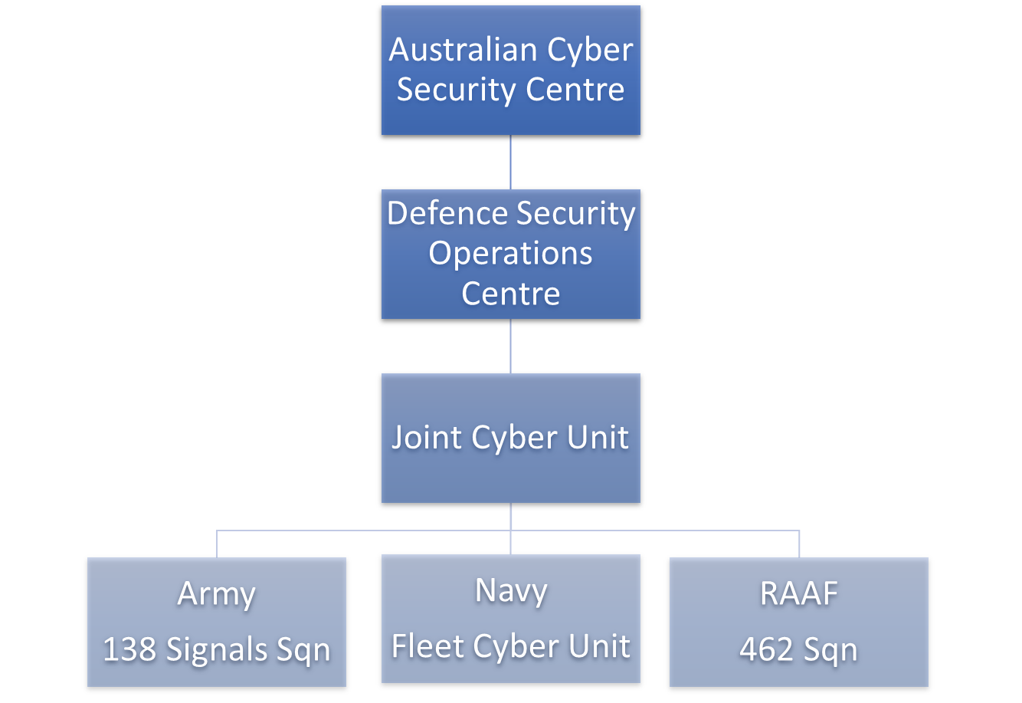


ADF Cyber Structure
Whole of Government
Strategic Level
Operational Level
Tactical Level
Notes:
ADF Cyber Structure
This chart represents the ADF structure for Cyber capabilities.

Slide 44
The RACI Model
R
A
C
I
Responsible
Doing the Task
Accountable
Owning the Task
Consulted
Assisting
Informed
Keeping Aware
RACI Model
https://en.wikipedia.org/wiki/Responsibility_assignment_matrix
Notes:
The RACI Model is a straightforward tool used for identifying roles and responsibilities and avoiding confusion over those roles and responsibilities during a project.
RACI Matrix Key
R
Responsible: Doing the Task
This person actions the task or deliverable. They are responsible for getting the work done or making the decision.
A
Accountable: Owning the Task
This person or role is responsible for the overall completion of the task or deliverable. They won’t get the work done but are responsible for making sure it’s finalised.
C
Consulted: Assisting
This person, role or group will provide information useful to completing the task or deliverable. There will be two-way communication between those responsible and those consulted.
I
Informed: Keeping Aware
These people or groups will be kept up to date on the task or deliverable. This could be on progress, or when the task or deliverable is completed.
They won’t be asked to feedback or review, but they can be affected by the outcome of the task or deliverable. There should be one-way communication to these roles or groups.
The idea here is that the participant get taken from the Whole of Government responsibility, to divisional responsibility and then responsibility to a task level. This RACI model is to start to introduce the specific Incident response task and that this section can tie into tomorrows section focusing on incident response.

Slide 45




RACI cont.
An example of a RACI Model
Project Activity | Role A | Role B | Role C | Role D
Task 1 | C | I | R | A
Task 2 | A | I | R | I
Task 3 |  | A | R | I
Task 4 | R | A | I | C
Task 5 | A |  |  | C
Task 6 |  |  | A | R
Task 7 | C | R | C | R
Notes:
This slide is to show the participants an example of a RACI model.
Role A, Role B etc is usually a team or a job title. It is not usually a specific person so that in the case where the person has moved on and another person takes over then that role is responsible or accountable.
Each task is listed of the left had side. It then determined who is accountable, who is responsible, who is consulted and who is informed of this task. If a team is not involved at all in this task than that space can be left blank.
This leads into the exercise that is to follow.
The participants need to find the title of the roles at the top of the spreadsheet (specific to the ADF) and then try to fill in the chart the tasks.
It is not expected that they will know the answers but this is just to help the participants to think about who is doing what.

